Slide 1
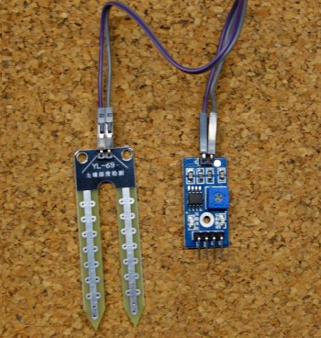
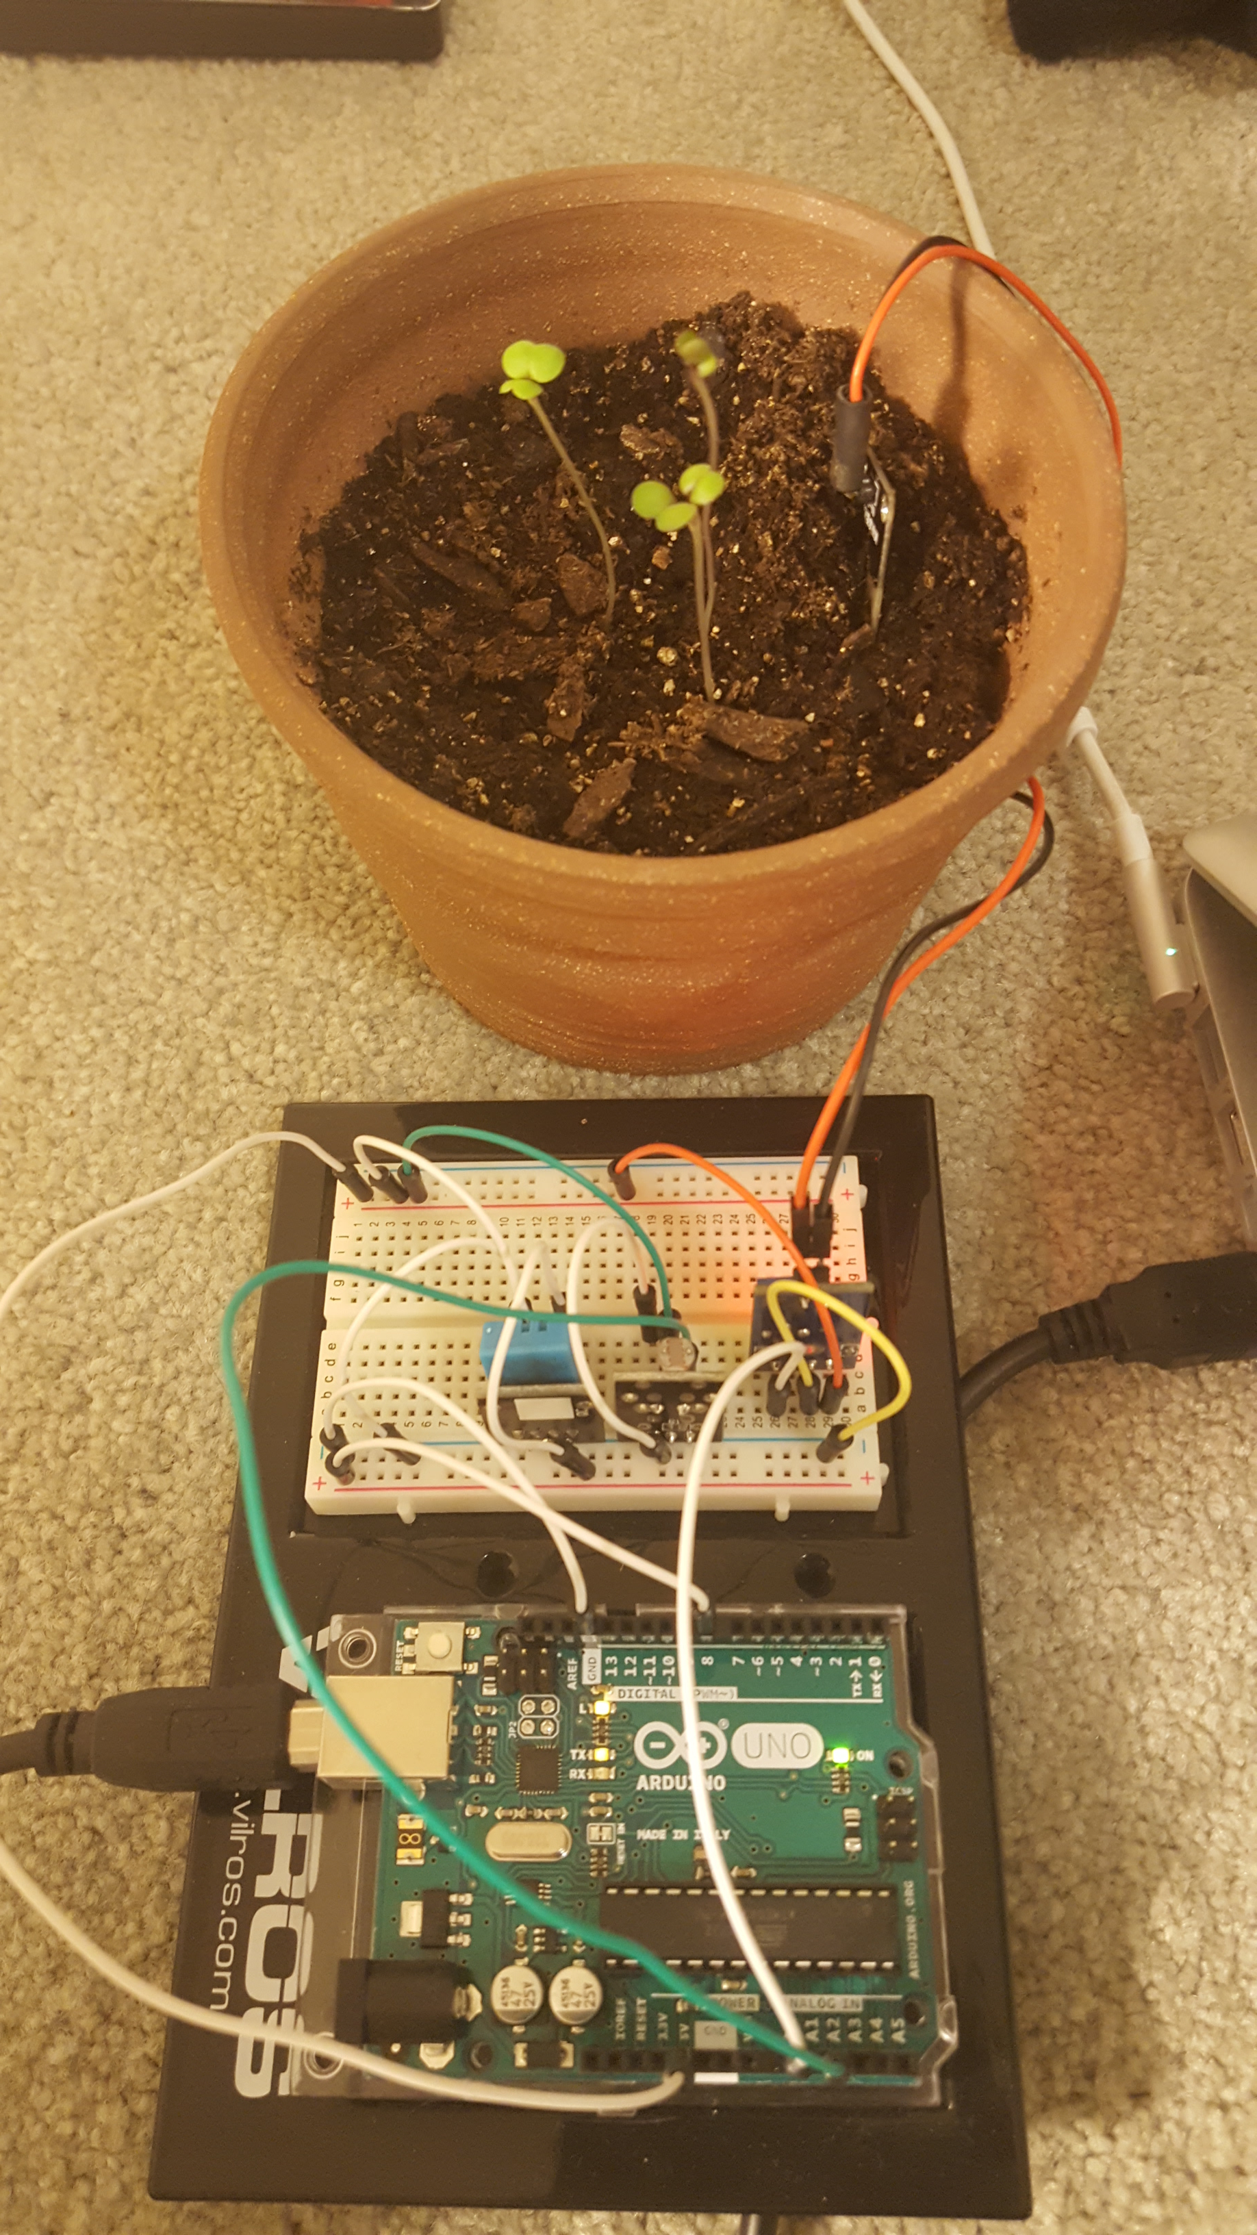
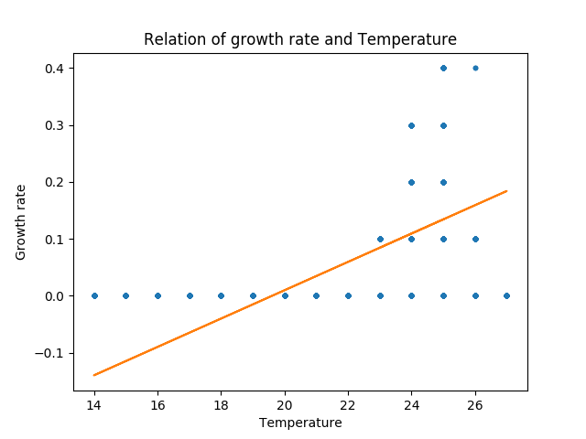
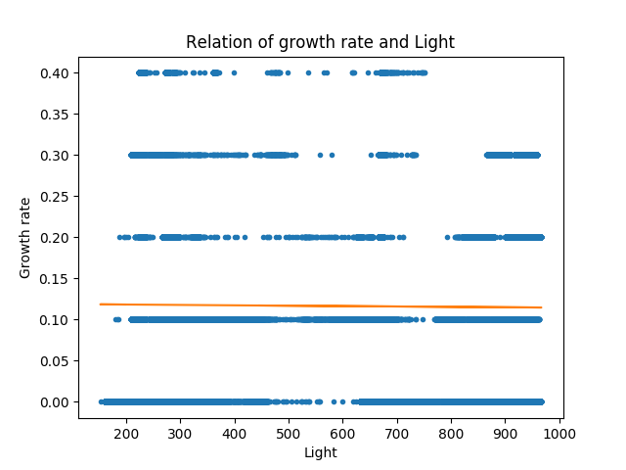
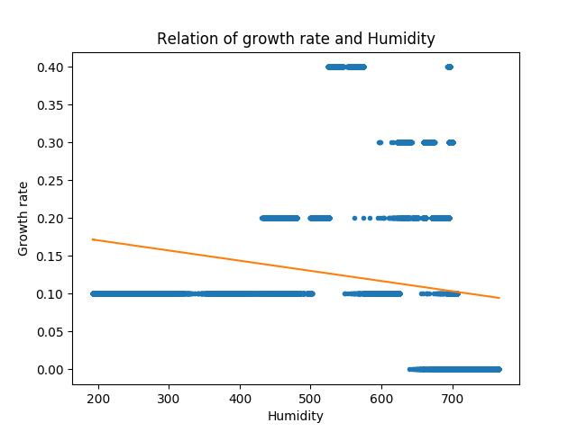
Monitoring and Reacting to Real-time Greenhouse Environment
Based On Machine Learning
Shihao Chen
INTRODUCTION
According to a news article on WHO[1], about 815 million people suffered from starvation in 2016 [1]. Among developing countries, starvation is still an emerging daily problem that requires a solution.
Thus, I have thought of a potential way to help solve this problem using cheap sensors and a machine learning algorithm. A sole seed takes approximately 4 to 7 days to germinate, and depending on the species, a distinct environment is required.
The focus on this project is to ultimately develop a complete system to measure the environmental conditions and respond to changes. Additionally reducing human assistance, time, resource costs, and developing an efficient eco-friendly farming system.
DISCUSSION
The diagrams (Figure. 3) shows the relation of each condition with growth rate. As the result, growth rate rises as temperature increases, declines as humidity increases. However, as light gets dimmer, the growth rate slightly decreases.
ACKNOWLEDGEMENT
This work is supported by Charles Peck and David Barbella from Computer Science Department, and Daniel Thompson from Biology Department.
Figure 2. Sets of sensors to assess environmental conditions.
Humidity sensor set YL-69 and YL-39 on the top. Temperature sensor KY-015 on the left, and light intensity on the right KY-018. [2,3,4]
Figure 1. A data collecting circuit and growing plant on day 4
METHODOLOGY
Hardware
Arduino set
Sensors
(YL-69, YL-39, KY-018, KY-015)
Greenhouse
Software
Arduino data collecting
Data processing with machine learning
Python Scikit-learn module
With a complete Arduino set (Fig. 1, 2) having input from a computer, and actively collecting data with a frequency of once per second, the recorded data including Temperature, Humidity, and Light intensity outputs into a csv file. After the data have been completely collected, a piece of python code which runs on Scikit-learn takes data and predicts the growth rate with various conditions.
REFERENCE
[1] Silva, J. G., Houngbo, G. F., Lake, A., Beasley, D., & Ghebreyesus, T. A. (2017, September 15). World hunger again on the rise, driven by conflict and climate change, new UN report says. Retrieved April 09, 2018, from http://www.who.int/mediacentre/news/releases/2017/world-hunger-report/en/
[2]R. (n.d.). Guide for Soil Moisture Sensor YL-69 or HL-69 with the Arduino. Retrieved April 09, 2018, from https://randomnerdtutorials.com/guide-for-soil-moisture-sensor-yl-69-or-hl-69-with-the-arduino
[3] KY-015 Temperature and Humidity Sensor Module. (2017, November 23). Retrieved April 09, 2018, from https://arduinomodules.info/ky-015-temperature-humidity-sensor-module/
[4]KY-018 Photoresistor Module. (2017, November 24). Retrieved April 09, 2018, from https://arduinomodules.info/ky-018-photoresistor-module/
Figure 3. Relation of each conditions with growth rate. The larger the number is at the x-axis of relation of growth rate and light, the dimmer it is. As the x-axis on the relation of growth rate and humidity diagram grows, the humidity increases.

