Slide 1

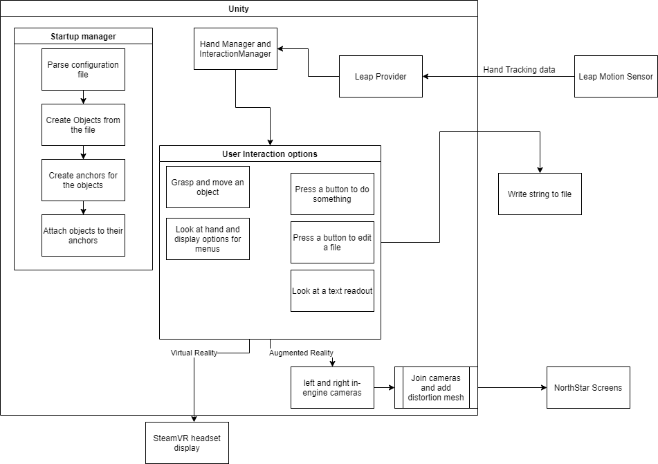
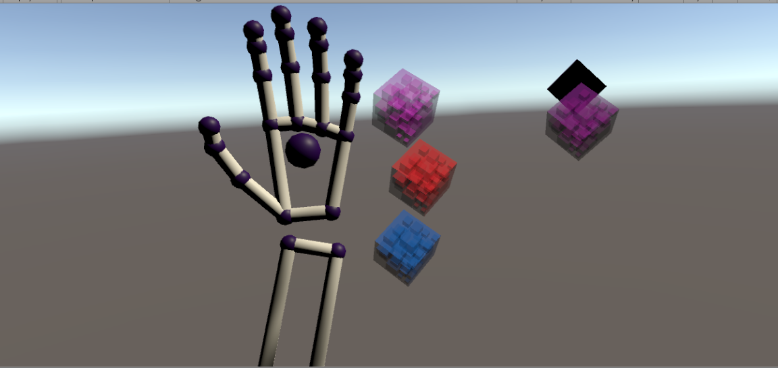
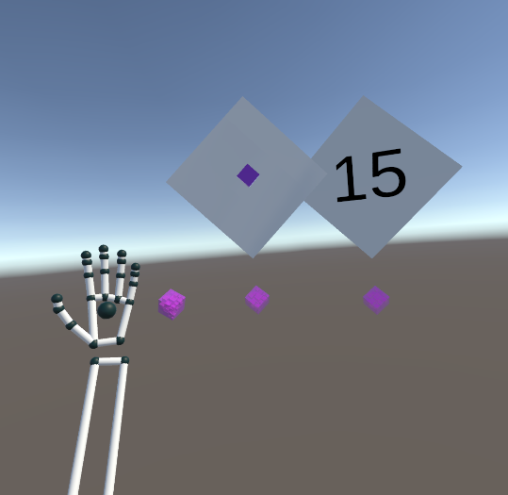
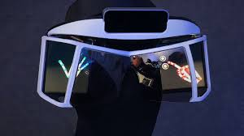
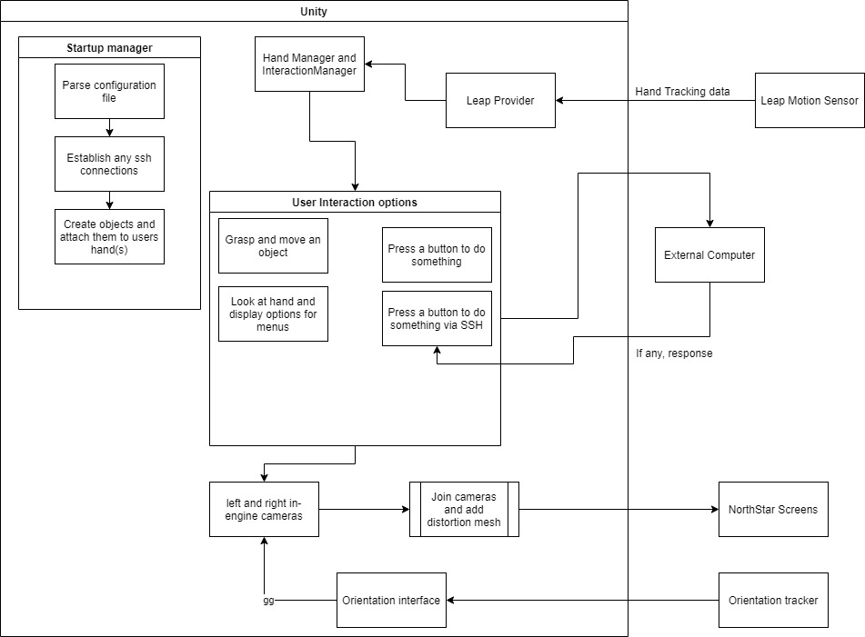
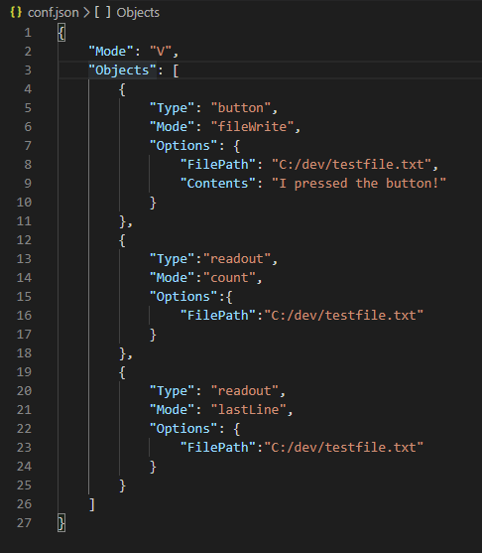
A Dynamic User Interface Generated from JSON for Augmented and Virtual Reality Systems Using the Leap Motion Sensor
Laurence Ruberl ‘20
Introduction and Motivation
Capabilities
User interfaces generated directly from JSON are relatively rare, especially with regards to Virtual Reality and Augmented Reality
The Leap Motion Sensor is a tool to allow for complex hand tracking with a single sensor and makes up the core of the Project NorthStar Augmented Reality headset
The result of this project is a user interface that is generated directly from JSON. It is design for displaying data and interacting with other programs or even computers in real time.
Users can define what they want in a single JSON file
Objects that users define will start collapsed and attached to their left hand
The proof of concept contains the following items that can be created
  Buttons that can write a line to a file
  Text readouts that can either count the number of lines in a file in real time or display the last line in
Above: Software diagram of the entire application.
Right: A rendering of the Project NorthStar headset with the Leap Motion Sensor prominently on the top
Left: Development screenshot of a user with one UI object on their hand and two already deployed in the air: a button and a readout showing how many lines are in a certain file.
Below: A sample configuration file that defines a button that writes the line “I pressed the button!” to a file, a text readout that counts the number of lines in the same file, and another text readout that displays the last line of a file. This is also the configuration file for the example at left.
Technologies
Future Work
Primarily aimed at the Project NorthStar Augmented Reality headset
Also supports OpenVR and SteamVR compatible VR headsets
Uses an Anchor system to attach objects to the user’s hand when not in use
  Users can look at their left hand to reveal all objects attached to anchors
  Users can then use their other hand to grasp an object and drop it into space where it deploys its associated user interface element
.
Customization of colors, sizes of panels, and other cosmetic factors.
Customizable labels for buttons and readouts.
Ability for buttons to send commands over SSH to other computers
Acknowledgements
Dr. David Barbella, Dr. Charles Peck, The Earlham College Department of Computer Science and The Project NorthStar Development Community and Discord server.

